Slide 1
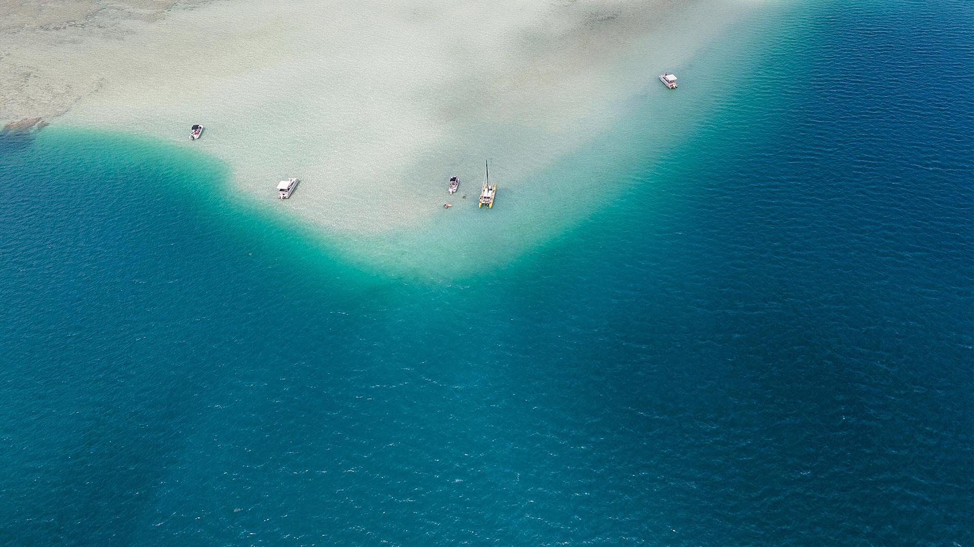
Jacques-Yves Cousteau
a French naval officer, oceanographer, filmmaker and author

Slide 2
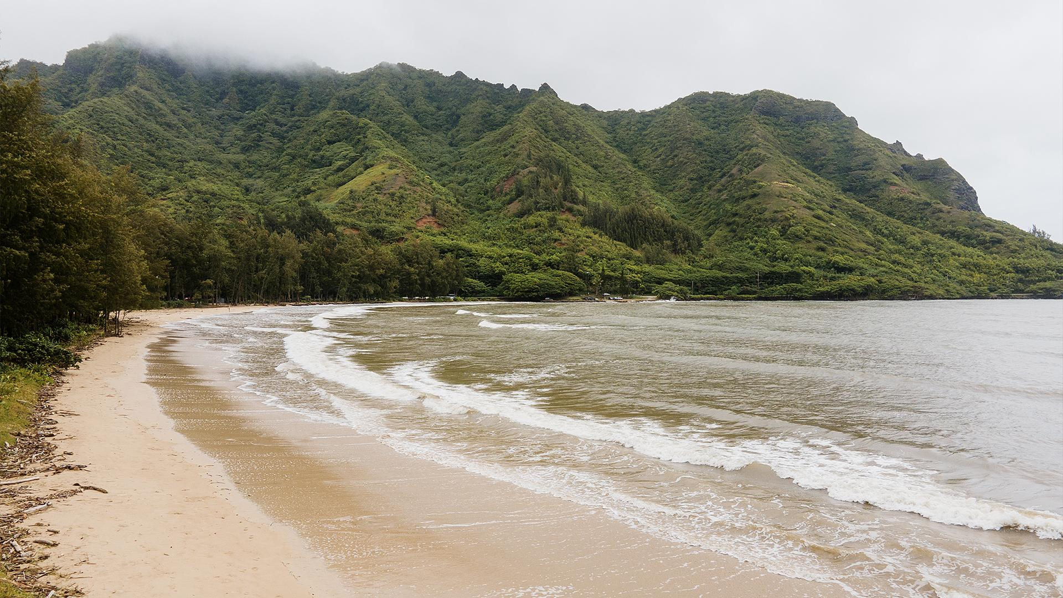
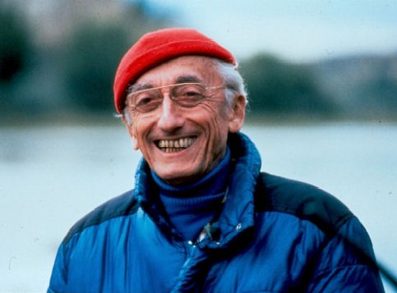
Biography
Cousteau was born on 11 June 1910, in Saint-André-de-Cubzac, Gironde, France and died on 25 June 1997. On 12 July 1937, he married Simone Melchior, his business partner. They have two sons and thats sons take part in the adventures of the Calypso.
In 1991, six months after his wife Simone's death from cancer, he married Francine Triplet. They already had a daughter and son, who was born while Cousteau was married in his first wife

Slide 3
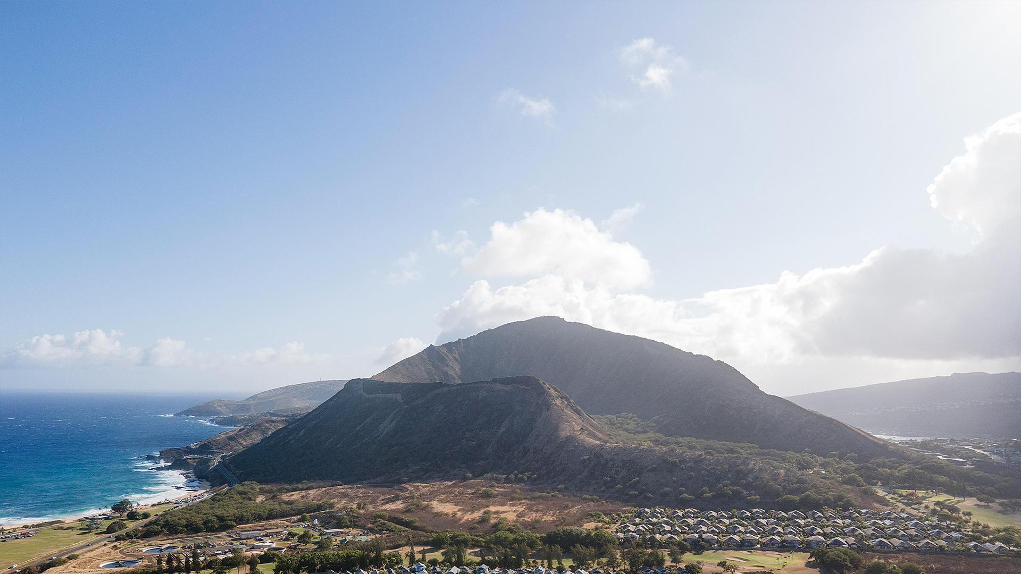
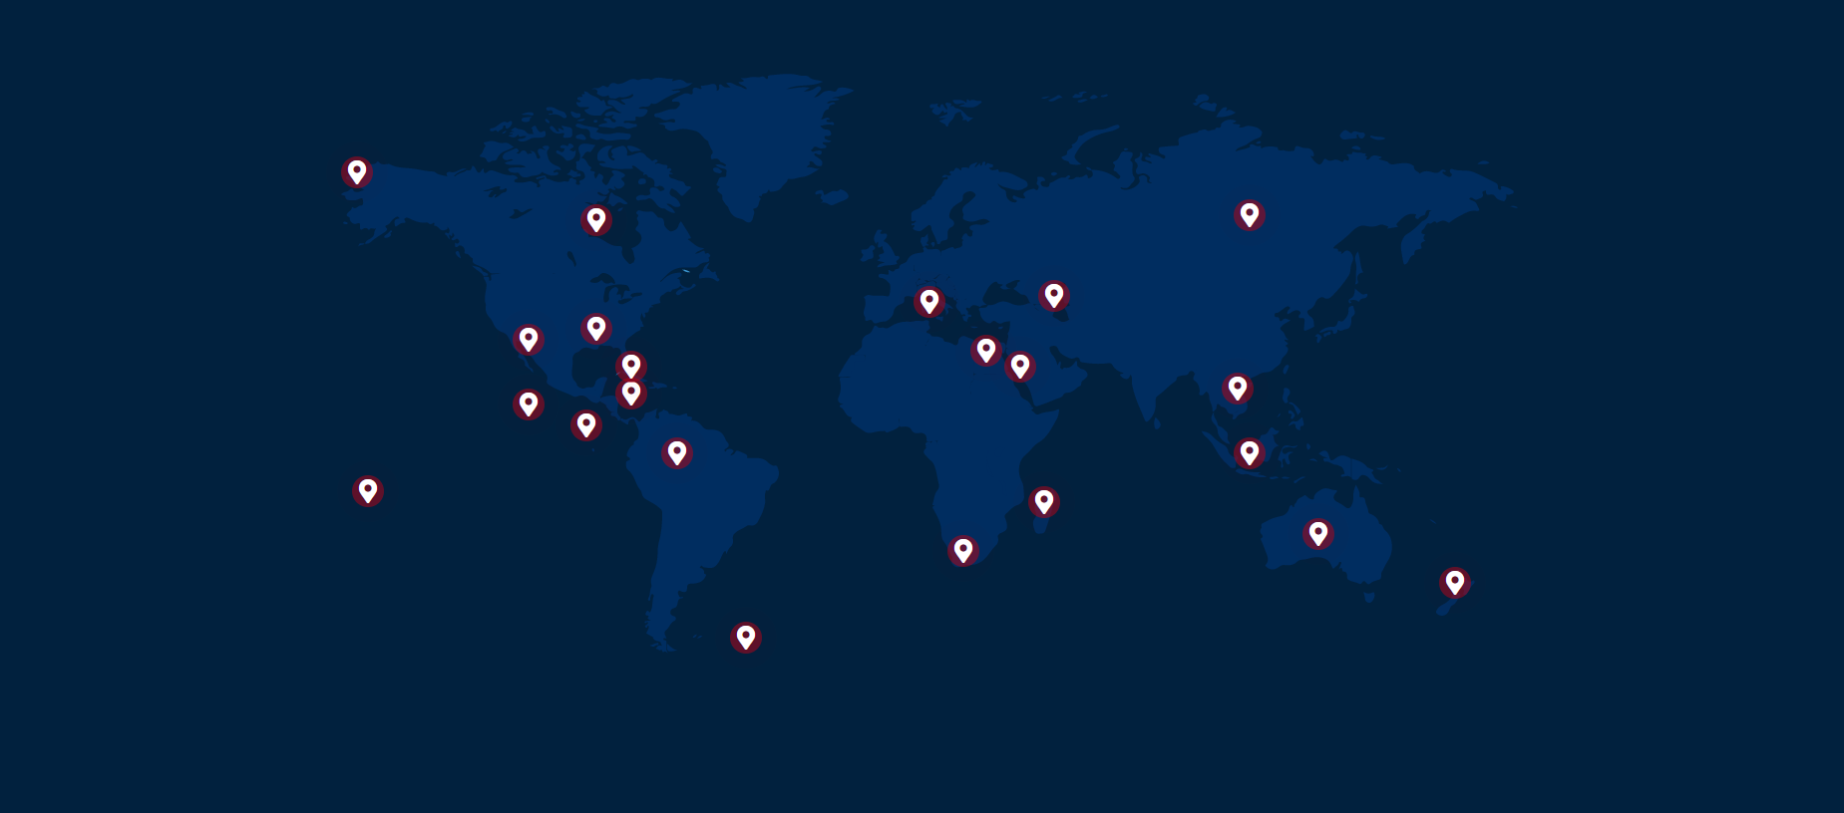
Map of his expeditions

Slide 4
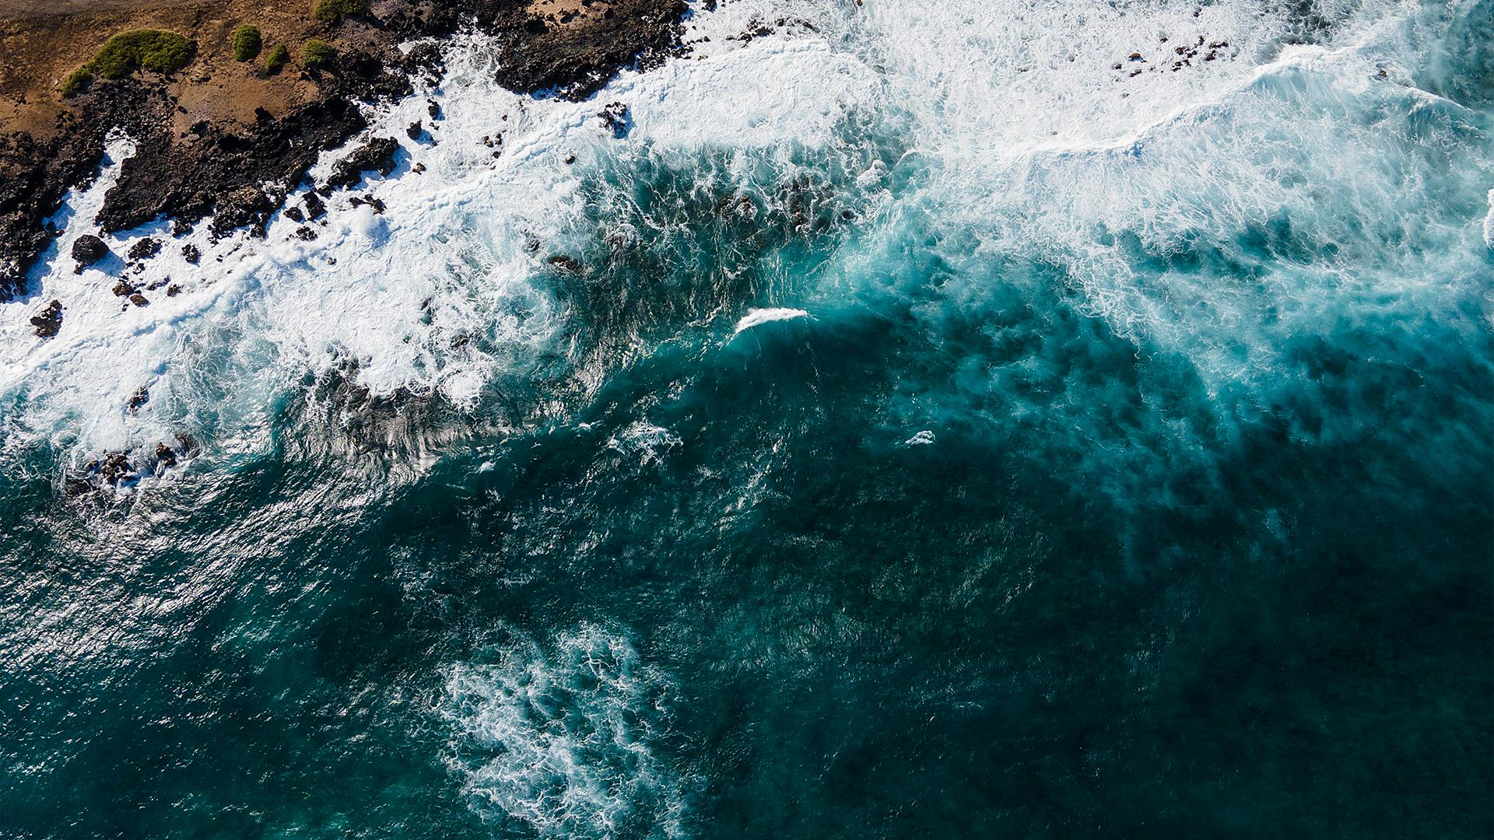
Expeditions
Alaska
Canada
Madagascar
1989
«You can walk for days on end without meeting another living soul»
In the early 1980’s
«The Nature that the crew encountered was grandiose, but also damaged»
1994
«A future harmony between humans and Nature was still possible»
Mississippi
Caribbean Sea
Nile
1983
«From the air, a flying team recorded the broad sweep of the Mississippi, dubbed the “Father of Waters” by the Indians.»
1974
«Each shipwreck has a story—that of an owner, a captain, a crew…»
1979
«From its source in Lake Victoria in Uganda to the Delta at Cairo, the Nile crosses marshes and falls, bringing life wherever it flows»

Slide 5
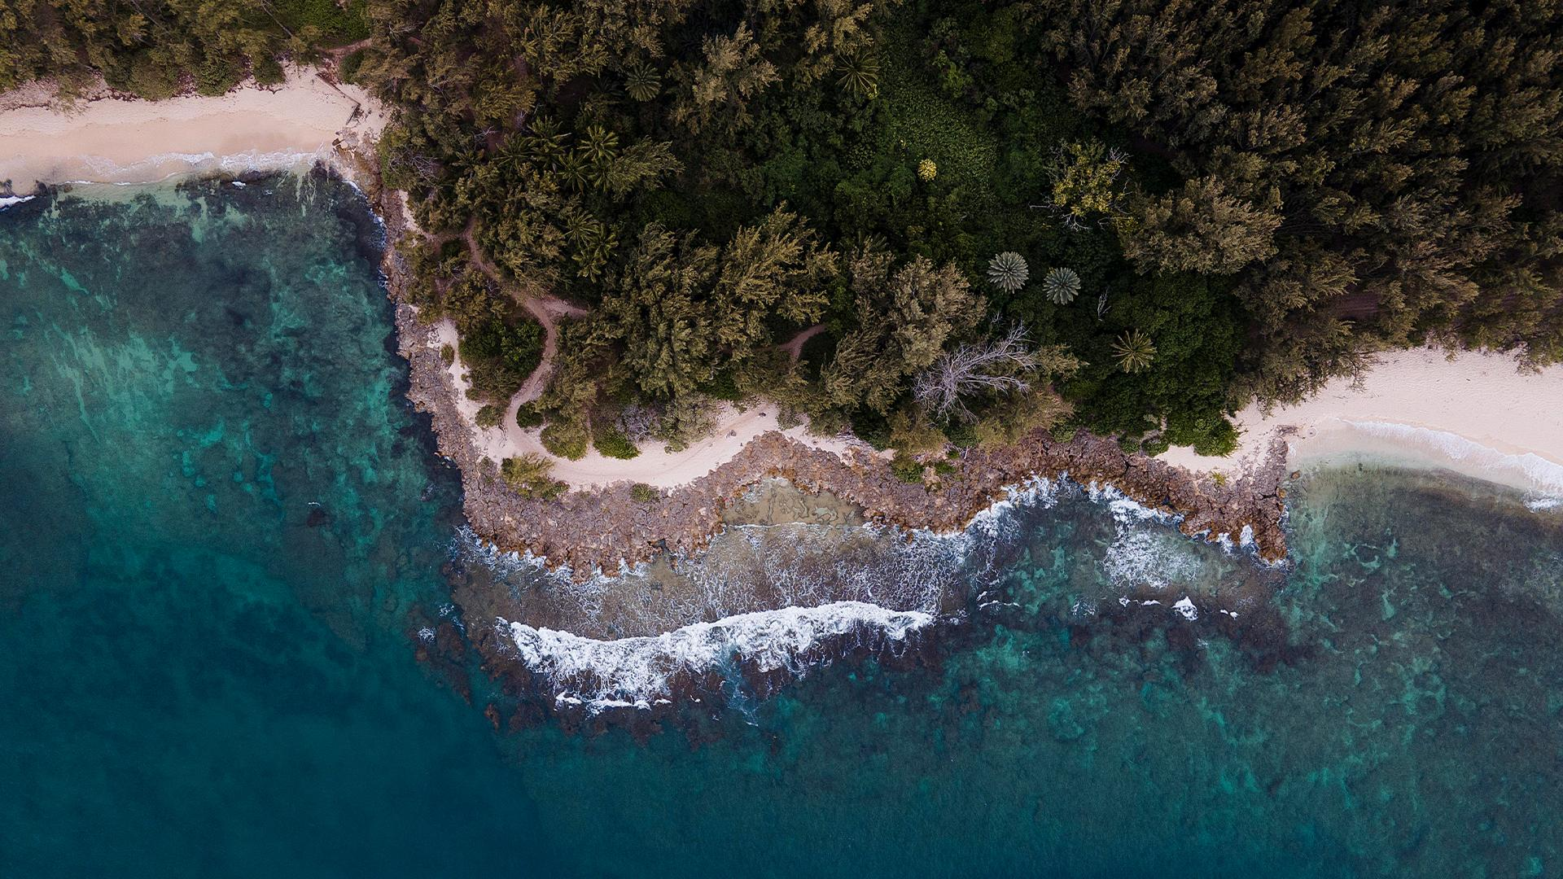
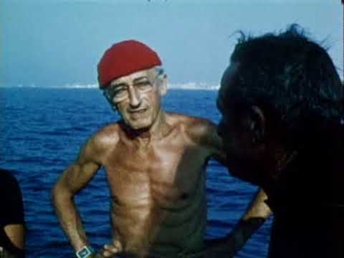
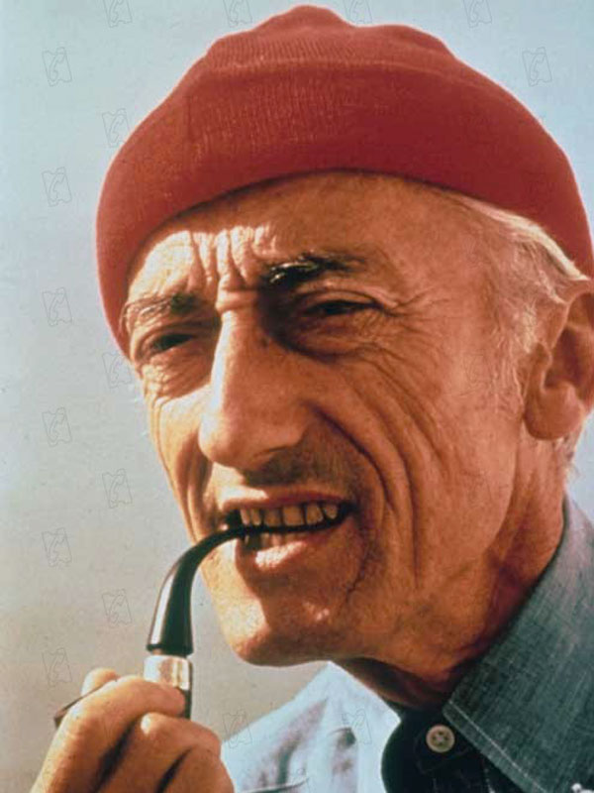
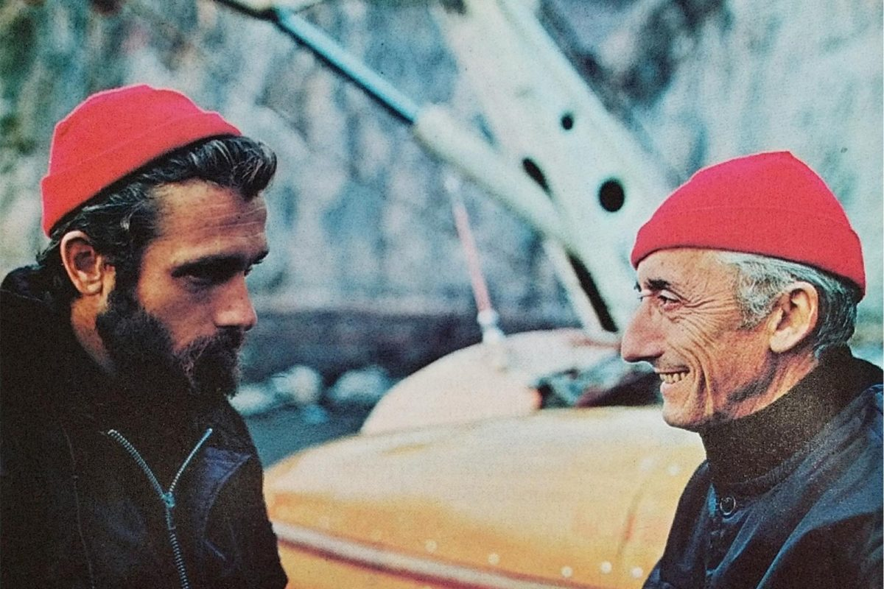
A RED HAT
Jacques Cousteau's signature red beanie was worn in homage to the 18th-century prisoners of Toulon, who were forced to test-dive the earliest metal diving suits. They had to sport red caps to differentiate them from the other port workers.
It was a woolly red hat
Cousteau gets a lot of mention on Red Hat Factory. The legend, the sea farer — or more accurately, below-sea farer — the style guru for Red Hatters across the world

Slide 6
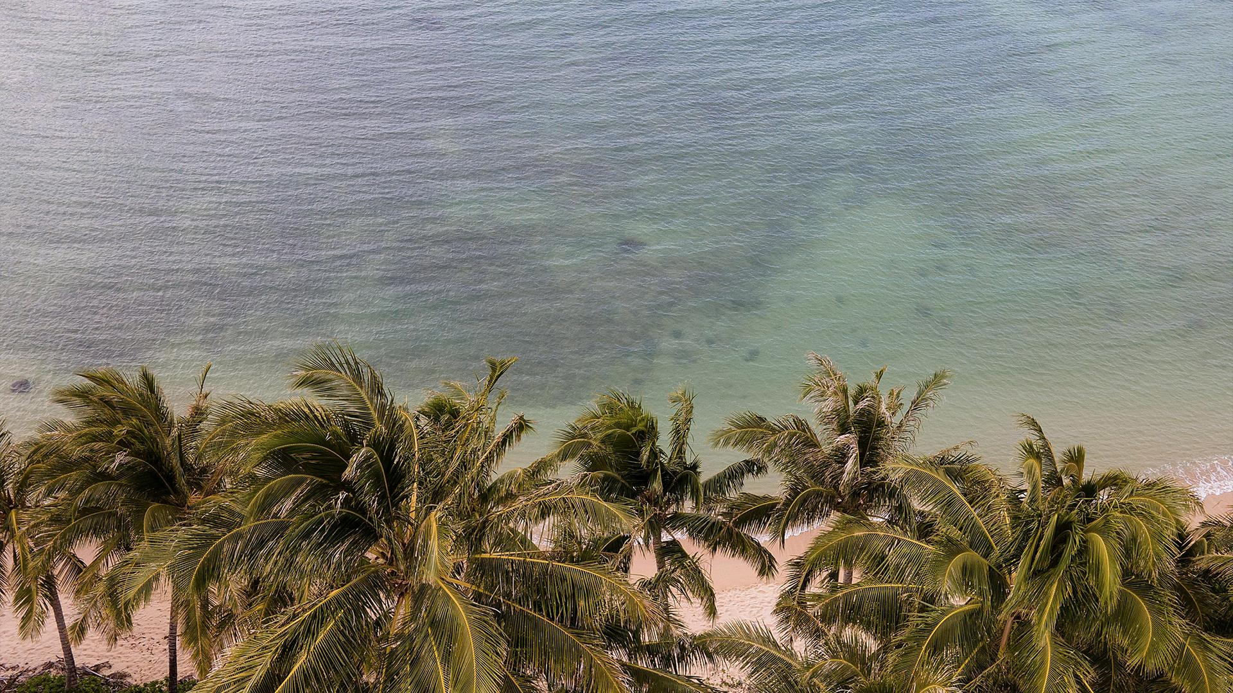

120
Number of Jacques Cousteau's expeditions

Slide 7
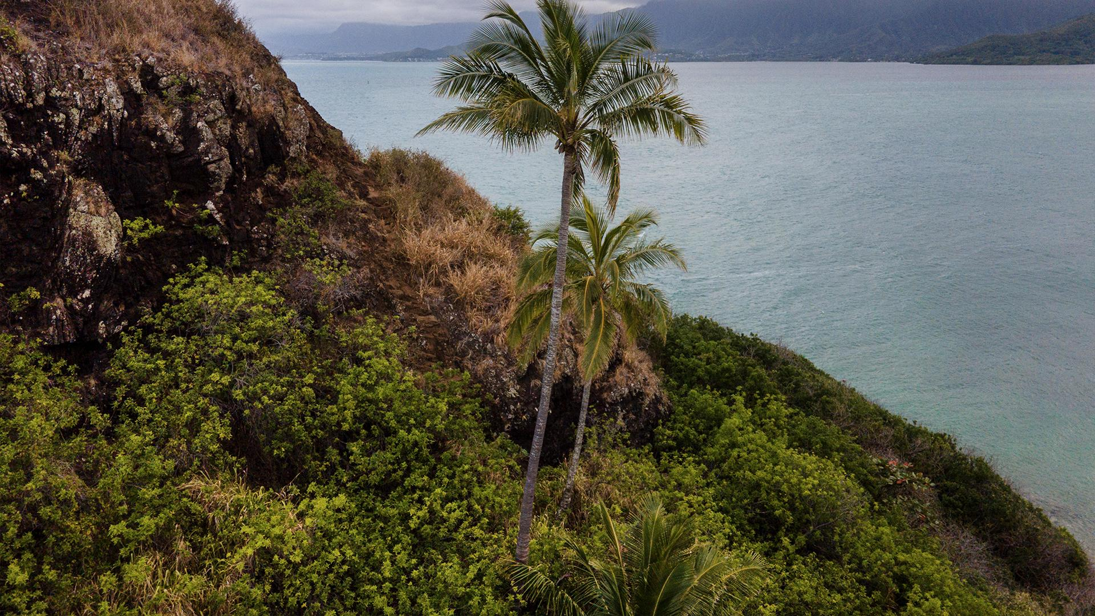
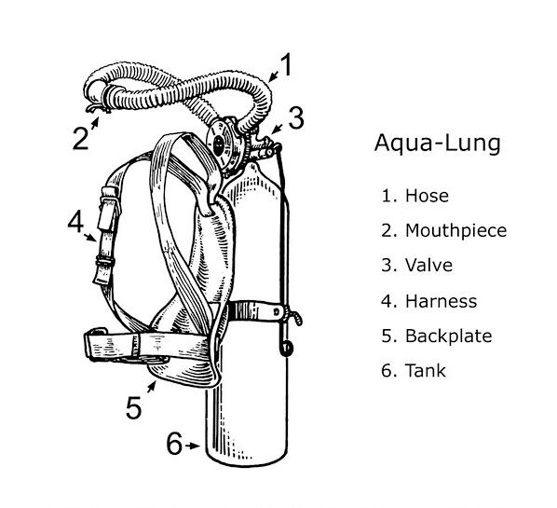
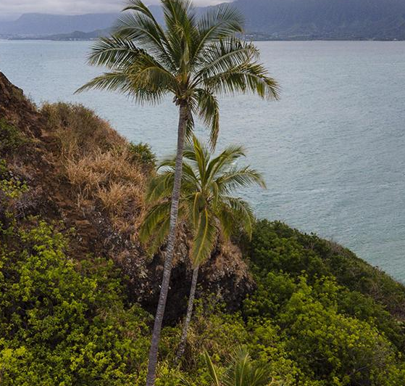
Cousteau's career
Cousteau's early career was in the French navy, where he trained as a gunnery officer and eventually became a captain. However, his passion for marine biology and oceanography led him to co-invent the Aqua-Lung, an underwater breathing apparatus that allowed divers to stay submerged for extended periods of time. This invention, along with his skill as a diver and filmmaker, enabled Cousteau to explore the oceans in ways that had never been done before.

Slide 8
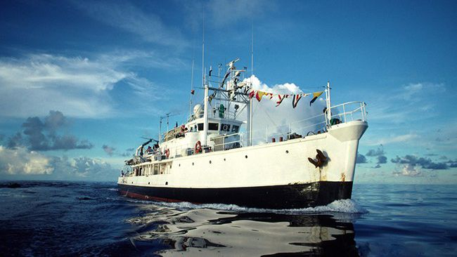
n 1950, Cousteau co-founded the French Oceanographic Campaigns (FOC), which conducted a series of expeditions aboard the Calypso, a converted minesweeper that served as a research vessel and floating film studio. Cousteau and his team explored and documented many of the world's oceans, from the Mediterranean to the Red Sea, from the Indian Ocean to the Pacific.
They made a number of groundbreaking discoveries, including the existence of previously unknown underwater ecosystems and the use of scuba diving for scientific research.

Slide 9
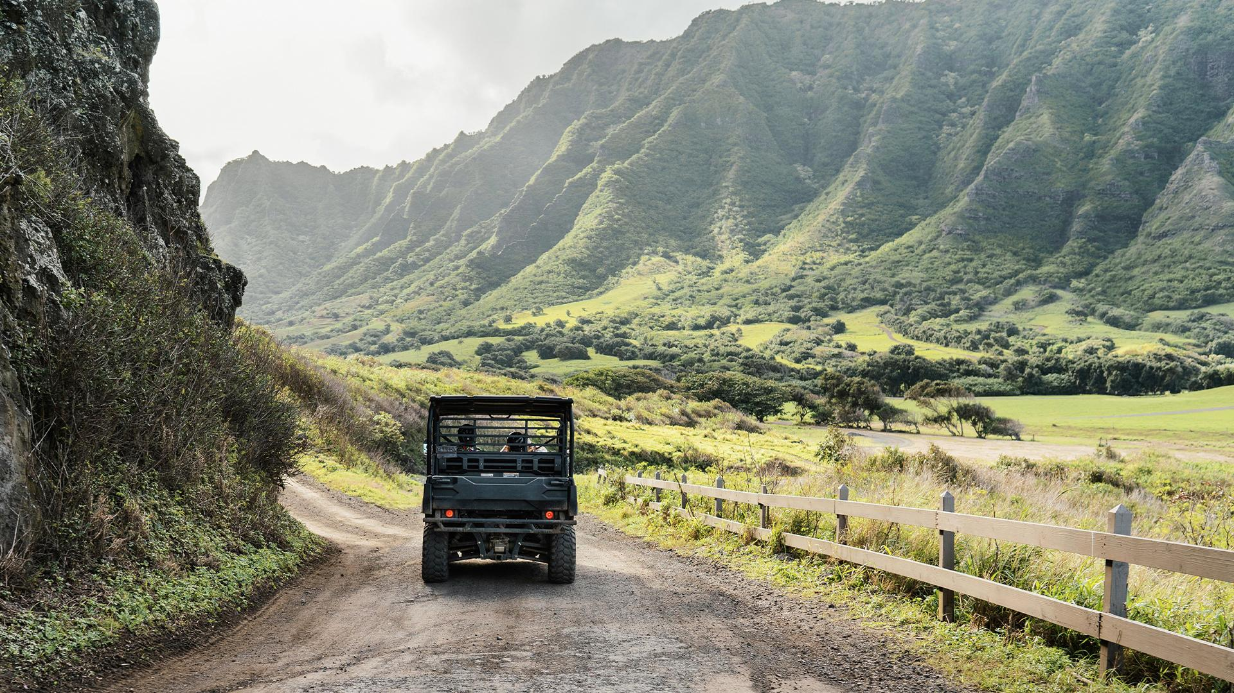
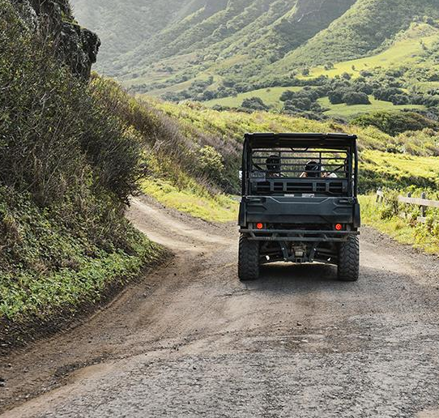
—Jacques Cousteau's
"The sea, once it casts its spell, holds one in its net of wonder forever."
‘22

Slide 10
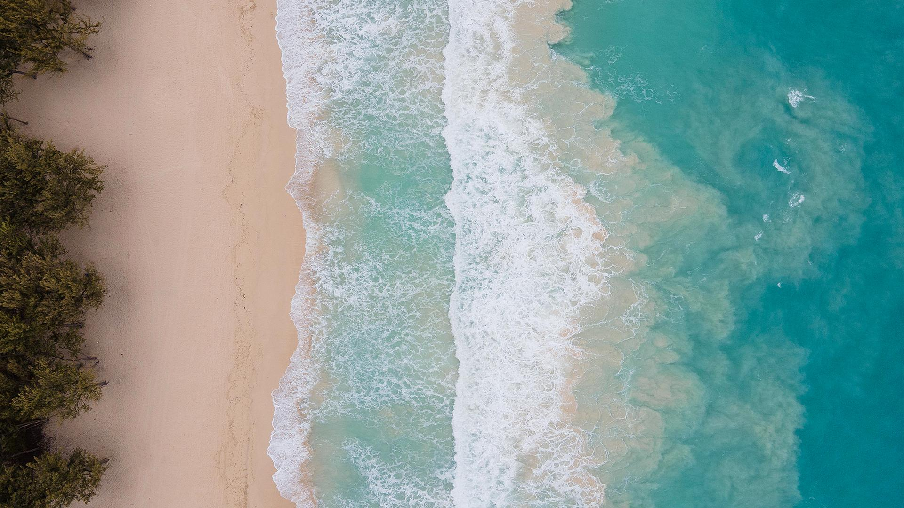
Jacques Cousteau's fun facts
One fun fact about Jacques Cousteau is that he was not actually his birth name. He was born as Jacques-Yves Cousteau, but he later added the hyphen and dropped his middle name to become simply Jacques Cousteau. He made this change in the 1940s, as he began to gain international recognition for his work in marine exploration and wanted a simpler and more distinctive name for his public persona.
Another fun fact about Cousteau is that he was a prolific inventor, with over 50 patents to his name. In addition to co-inventing the Aqua-Lung, which revolutionized underwater diving, he also developed a number of other underwater devices and instruments, including the underwater camera and the diving saucer. His innovative spirit and passion for exploration and discovery continue to inspire scientists and inventors around the world today.

Slide 11
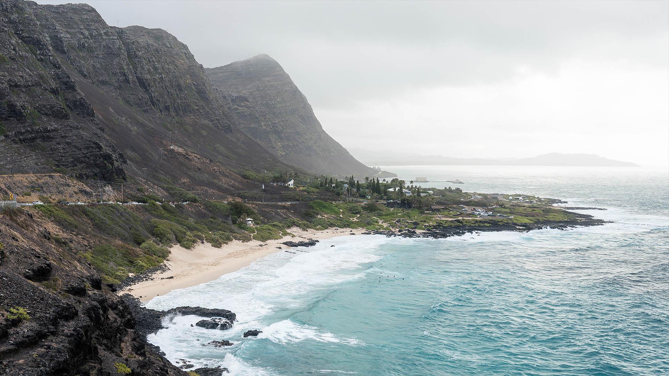















Thank you for your attention
Presentation made by
Natalia Makhnova and
Wiktor Gardyński
‘22

Slide 12
CORE VALUES
MERCURY
VENUS
MARS
JUPITER
SATURN
NEPTUNE
Mercury is the closest planet to the Sun
Venus is the second planet from the Sun
Despite being red, Mars is actually a very cold place
Jupiter is the biggest planet of them all
It’s composed of hydrogen and helium
Neptune is the farthest planet from the Sun

Slide 13
MARKET SHARE
MERCURY
It’s the closest planet to the Sun
JUPITER
VENUS
10%
25%
15%
50%
Despite being red, Mars is a cold place
Neptune is far away from Earth
The Moon is Earth’s only natural satellite
Saturn is a gas giant and has rings

Slide 14

MARKET SEGMENTATION
MERCURY
28%
Mercury is the closest planet to the Sun
VENUS
14%
Venus is the second planet from the Sun
MARS
3%
Mars is actually a very cold place
SATURN
53%
Follow the link in the graph to modify its data and then paste the new one here. For more info, click here
It’s composed of hydrogen and helium

Slide 15
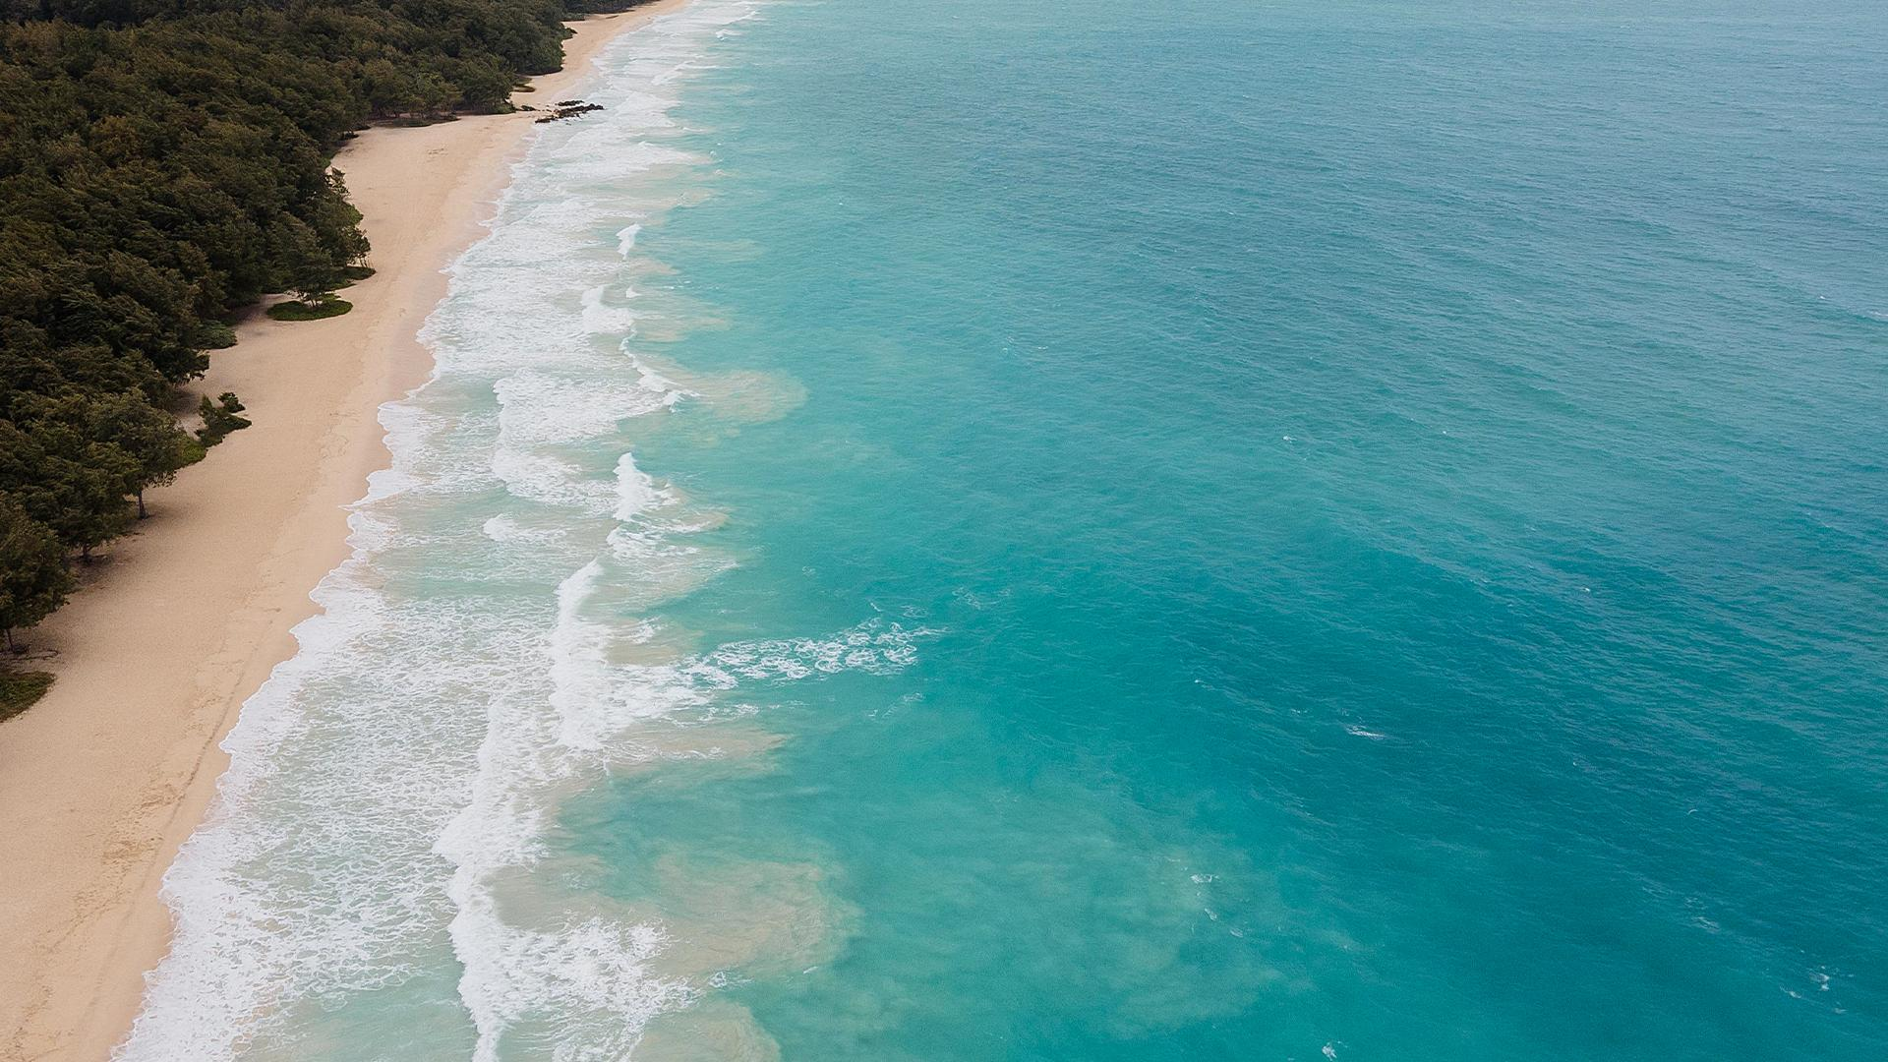
STRATEGY
STEP 1
STEP 3
Mercury is the closest planet to the Sun
The Moon is Earth’s only natural satellite
STEP 2
STEP 4
Pluto is considered a dwarf planet
Ceres is located in the main asteroid belt

Slide 16
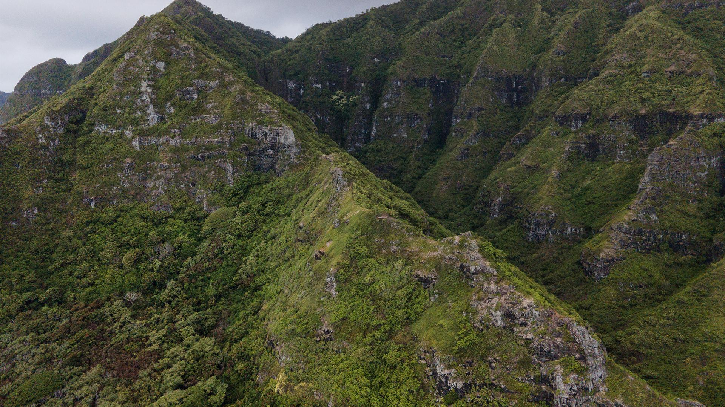
AWESOME WORDS
www.slidesgo.com
‘22

Slide 17
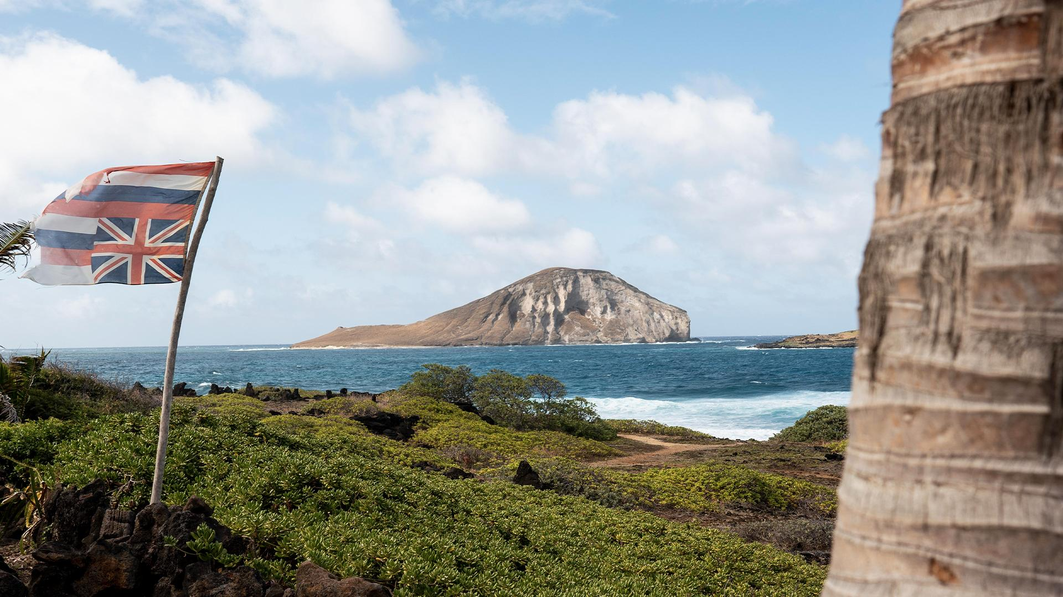
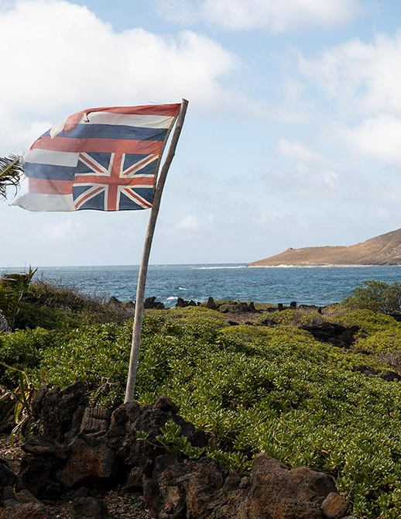
PRODUCT DESCRIPTION
MARS
VENUS
MERCURY
1
Despite being red, Mars is actually a cold place. It’s full of iron oxide dust
2
Venus has a beautiful name and is the second planet from the Sun
3
It’s the closest planet to the Sun and the smallest in the Solar System

Slide 18
PRICING
BASIC
PRO
PREMIUM
Despite being red, Mars is actually a cold place. It’s full of iron oxide dust
It’s the closest planet to the Sun and the smallest in the Solar System
Venus has a beautiful name and is the second planet from the Sun

Slide 19
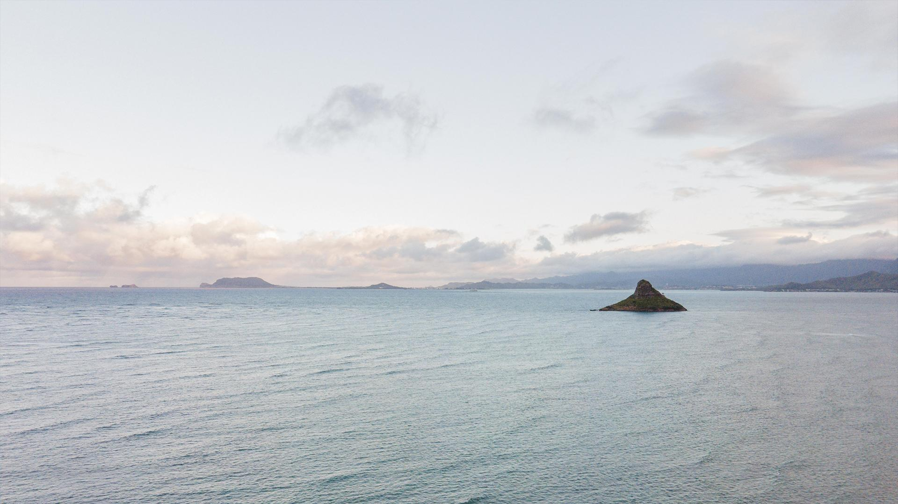
DISTRIBUTION CHANNELS
MANUFACTURER
WHOLESALER
RETAILERS
RETAILERS
The Moon is Earth’s only natural satellite
Ceres is located in the main asteroid belt
Despite being red, Mars is a cold place

Slide 20
PROMOTION
10%
30%
60%
Mercury is the closest planet to the Sun
Despite being red, Mars is a very cold place
Neptune is the farthest planet from the Sun

Slide 21
ADVERTISING CAMPAIGN 1
GOALS
STRATEGY
1
Neptune is far away from Earth
The Moon is a satellite
The Sun is a star
Earth harbors life
CHANNEL
2
Despite being red, Mars is a cold place
DESCRIPTION
$40,000,000
3
Venus is the second planet from the Sun
Budget
Jupiter is a gas giant and the biggest planet

Slide 22
ADVERTISING CAMPAIGN 2
DESCRIPTION
CHANNEL
$10,000.000
Neptune is the farthest planet from the Sun and the fourth-largest of them all
Saturn, the ringed planet, is composed mostly of hydrogen and helium
Big number
STRATEGY
GOALS
You can list your goals
You can list your goals
You can list your goals
You can list your goals
You can list your goals
40%
60%
Neptune
Jupiter

Slide 23
PR OUTREACH
MEDIA CHANNELS
GOALS
Jupiter
Saturn
Moon
Venus
10%
Mercury
20%
15%
35%
50%
Neptune
KEY MESSAGES
30%
The Sun is a bright star
Mars is actually a cold place
Earth is the third planet from the Sun
Venus
40%

Slide 24
BUDGET ALLOCATION
MERCURY | VENUS | JUPITER
- | $41,000 | -
$12,000 | $23,000.000 | -
$30,000 | - | $120,000
$7,000 | $68,000 | $40,000.000

Slide 25
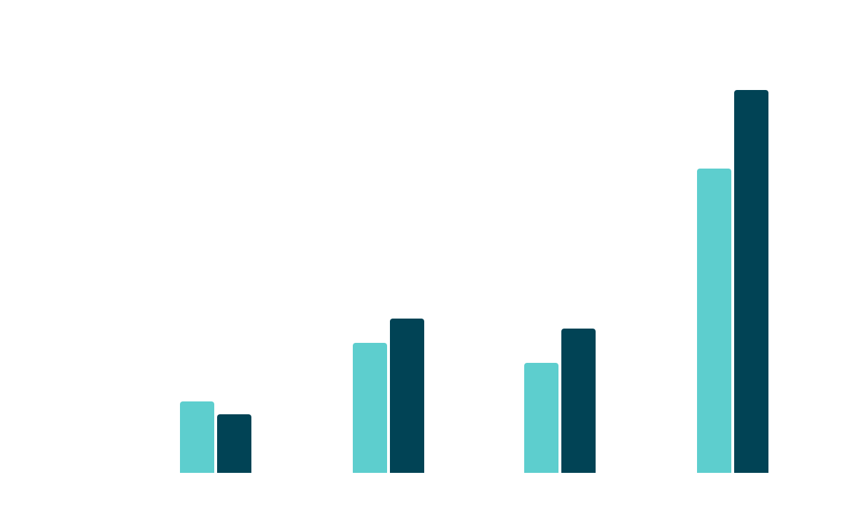
PREDICTED REACH
The Moon is Earth’s only natural satellite
MOON
MERCURY
Mercury is the closest planet to the Sun
MOON
The Moon is Earth’s only natural satellite
CERES
Follow the link in the graph to modify its data and then paste the new one here. For more info, click here
Ceres is located in the main asteroid belt

Slide 26
TIMELINE
MERCURY
CERES
1
2
Mercury is the closest planet to the Sun
Ceres is located in the main asteroid belt
MOON
VENUS
3
4
The Moon is Earth’s only natural satellite
Venus is the second planet from the Sun
PLUTO
MARS
5
6
Pluto is considered a dwarf planet
Despite being red, Mars is a cold place

Slide 27
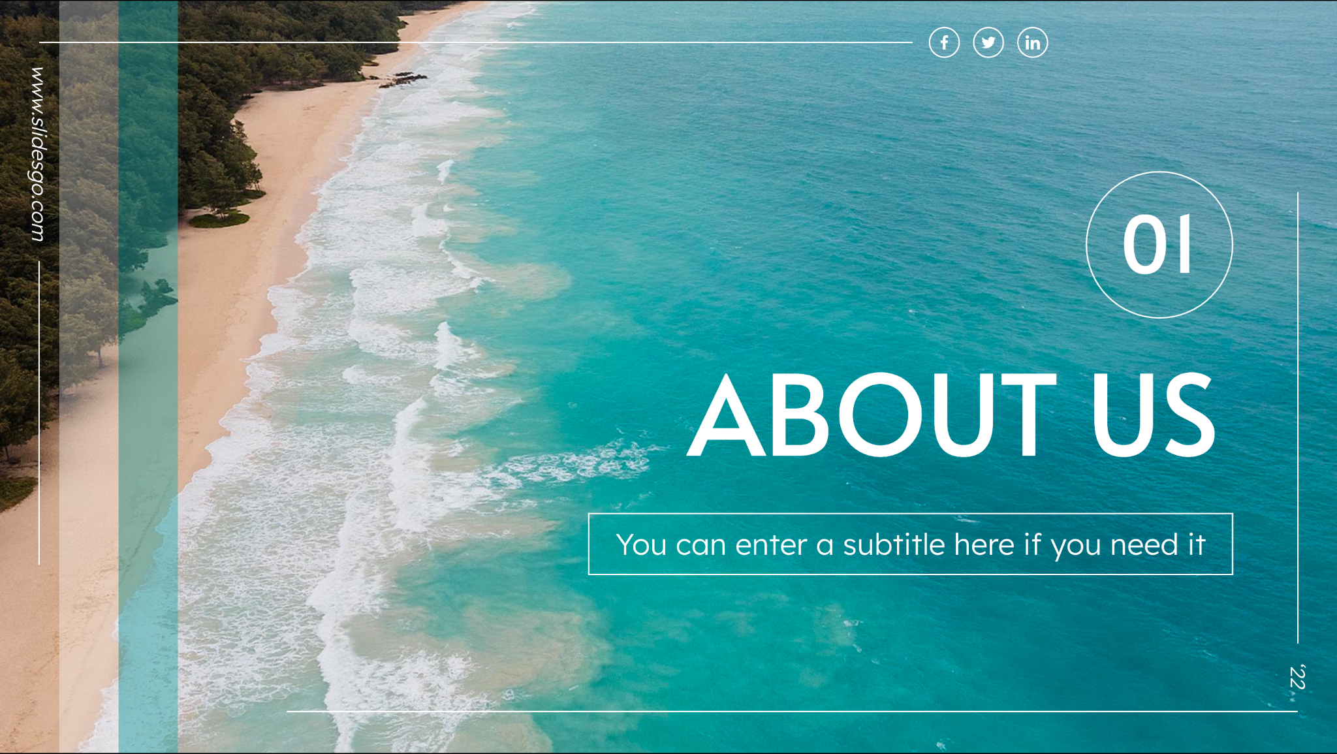
MULTIMEDIA
Insert your multimedia content here

Slide 28

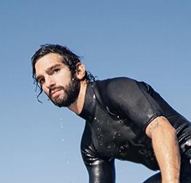
OUR TEAM
JENNA DOE
TIMMY JIMMY
You can speak a bit about this person here
You can speak a bit about this person here

Slide 29
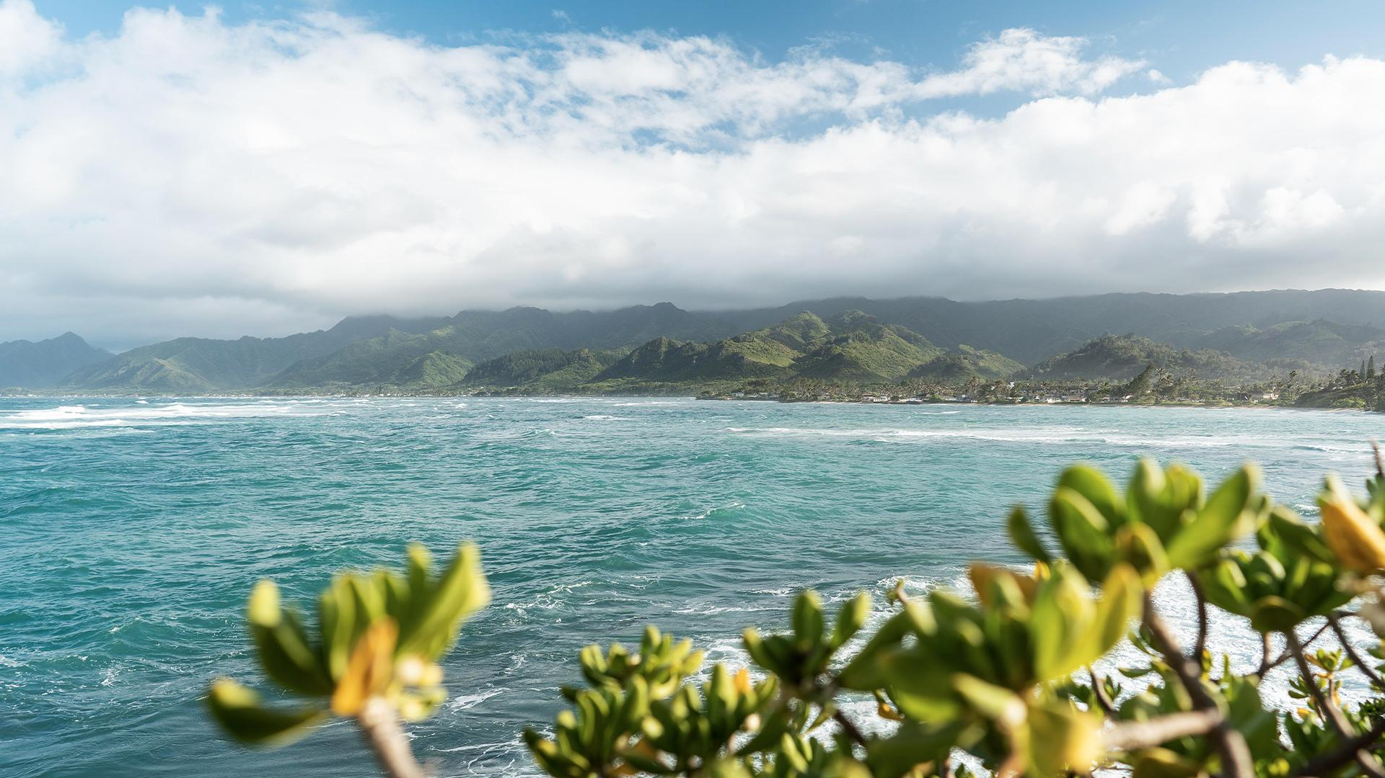
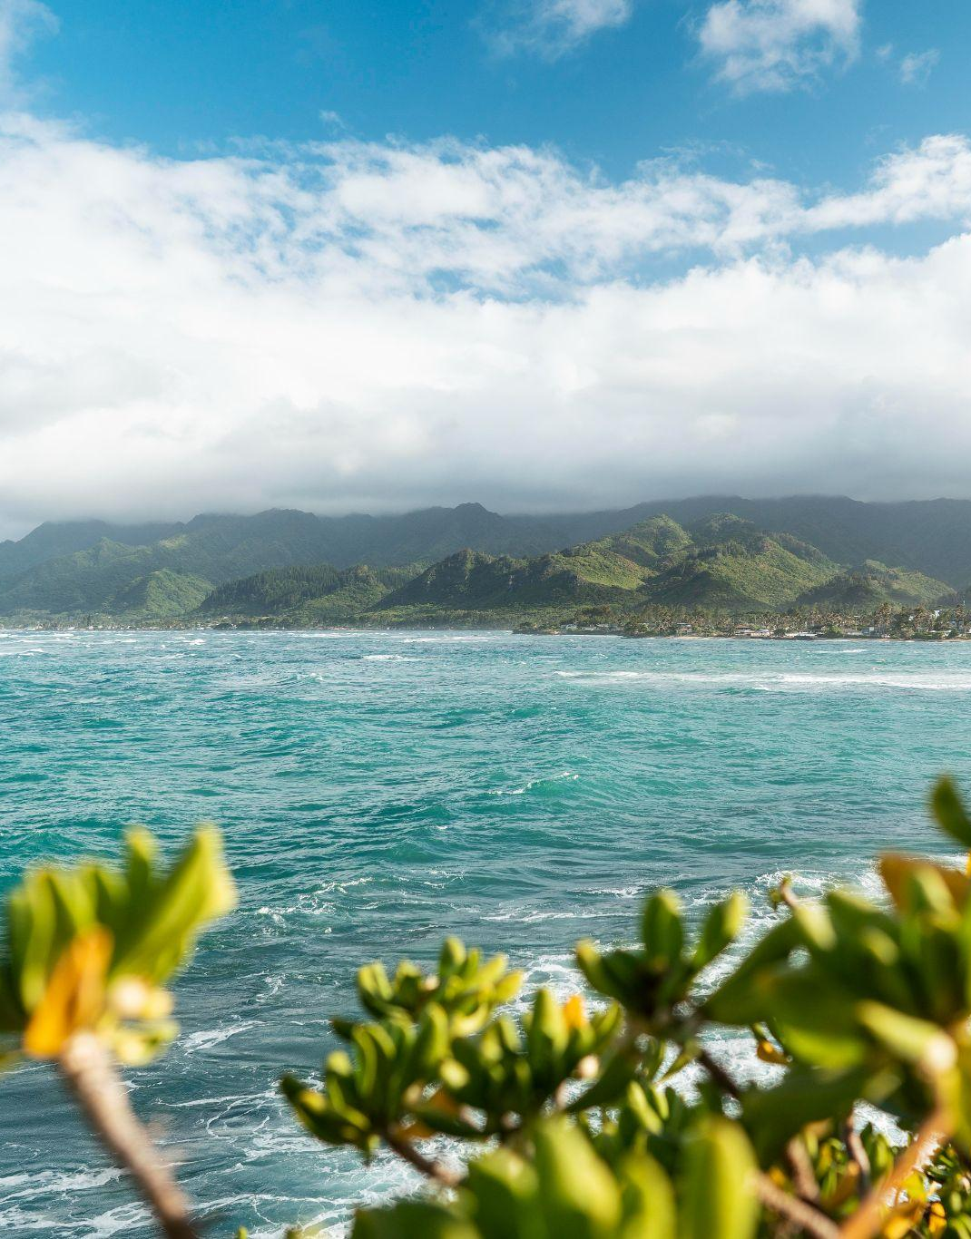
THANKS!
www.slidesgo.com
DO YOU HAVE ANY QUESTIONS?
youremail@freepik.com
+91 620 421 838
yourwebsite.com
Please keep this slide for attribution
‘22

Slide 30


